Slide 1

Implement a continuous-attractor network (CANN) with BrainPy

Slide 2
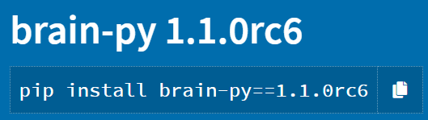
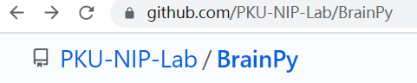
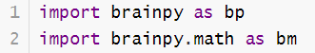
Install BrainPy
方法一：pypi
方法二：GitHub

Slide 3
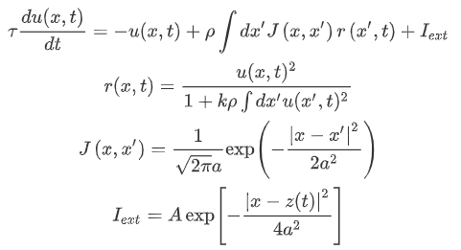
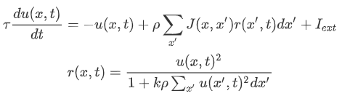
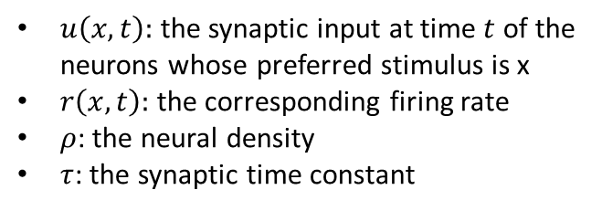
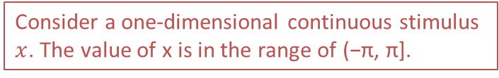
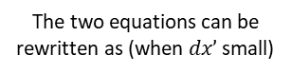
The continuous-attractor network to implement
The two equations can be rewritten as (when $dx’$ small)
$u\left(x, t\right):$ the synaptic input at time $t$ of the neurons whose preferred stimulus is x
$r\left(x, t\right):$ the corresponding firing rate
$ρ$: the neural density
$τ$: the synaptic time constant
Consider a one-dimensional continuous stimulus $x$. The value of x is in the range of (−π, π].
Three tasks:
Population coding
Template matching
Smooth tracking
Wu, Si, Kosuke Hamaguchi, and Shun-ichi Amari. "Dynamics and computation of continuous attractors." Neural computation 20.4 (2008): 994-1025.
Mi, Yuanyuan, et al. "Spike frequency adaptation implements anticipative tracking in continuous attractor neural networks." NeurIPS 27 (2014): 505-513.

Slide 4
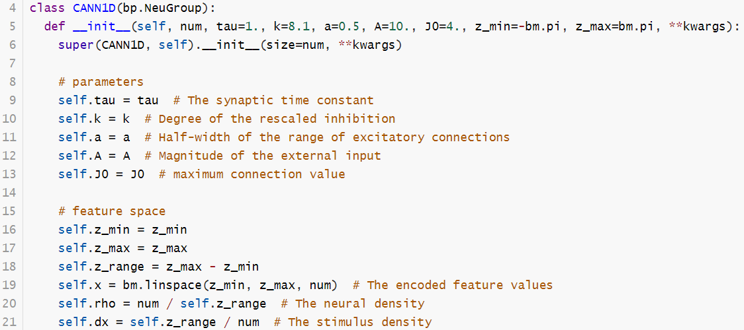
Implement the CANN with BrainPy
Necessary parameters

Slide 5
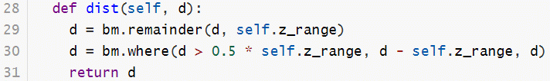
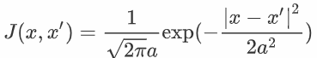
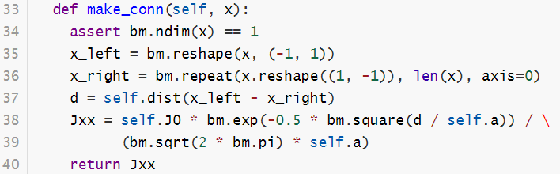
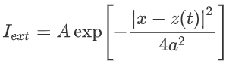
Function for the distance in the ring
Function for the connection
Function for stimulus

Slide 6
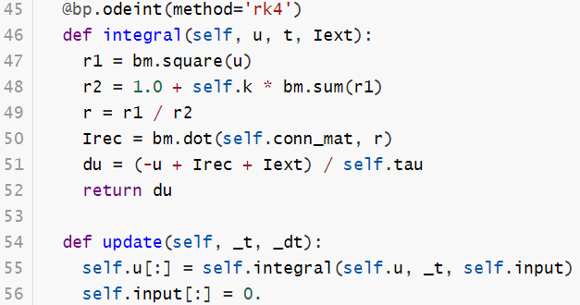
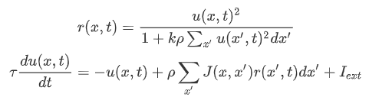
Update Function

Slide 7
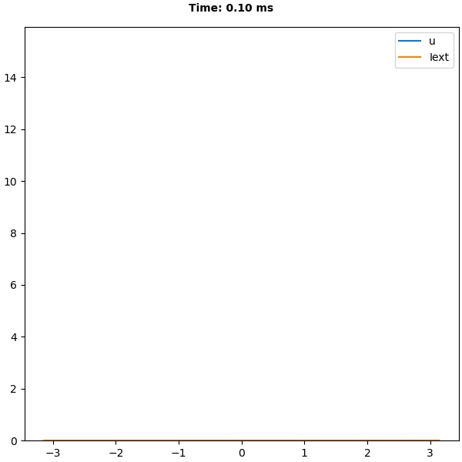

Slide 8
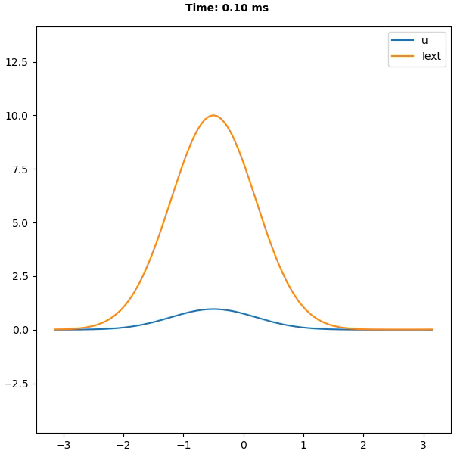

Slide 9
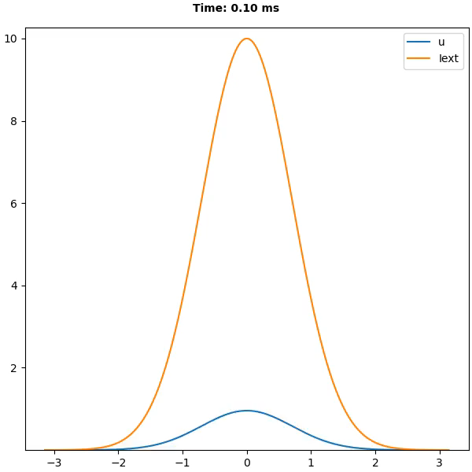

Slide 10
参考资料
https://brainpy-examples.readthedocs.io/en/latest/cann/Wu_2008_CANN.html

Slide 11
课后作业 Homework
1. 阅读文献 《2008 - Dynamics and Computation of Continuous Attractors》
2. 安装Anaconda Python环境(https://docs.anaconda.com/anaconda/install/)
3. 安装 BrainPy == 1.1.0rc6 (https://pypi.org/project/brain-py/1.1.0rc6/)
4. 【提交作业，代码 + report (配图)】实现上述PPT中 CANN 模型的3个tasks。
5. 以word或pdf的格式提交报告。将“代码+报告”打包以“姓名_学号_作业二报告.zip”命名，在11月16日24:00前发送到邮箱chutianhao@stu.pku.edu.cn

